Slide 1
Raising partner’s suit
Direct raises of partner’s suit require a 4 card holding in the suit
When partner opens with a major suit and you hold 4 cards in the suit, a direct raise should be your first priority. Sometimes you can raise a major suit with 3 cards, rather than bid 1NT
When partner opens with a minor suit and you hold 4 cards in the suit, bid another suit in preference to raising it direct , or bid no trumps
Do NOT raise to the 3 or 4 level with a 3 card suit even if you know partner has opened with a 5 card suit, unless opponents remove the bid you could have made

Slide 2
Two methods to decide how far to raise partner’s suit
The points method
6-9 pts raise to 2 level
10-12 pts raise to the 3 level
12-15 pts raise to the 4 level
Or better you can use the losers method using the losing trick count. Only for suit raises not no-trumps

Slide 3
The losing trick count
Counting losers
Each suit has a maximum of 3 losers
The number of losers in any suit cannot be greater than the number of cards in it
For each suit deduct a loser for an ace, king or queen
An opening bid in a suit is assumed to be 7 losers. Rarely 8, and can be less than 7.
A 1NT opening bid is often 8 losers
Adjustments for greater accuracy (for more advanced players)
One Q doubleton should count as 2 losers unless it is partner’s suit. Two Q doubletons however are 3 losers not 4
An hand with no aces or kings should count an extra loser
Be cautious about suits with 3 cards to the Q unless backed up with a J or 10
,

Slide 4
Using losers to determine the level to raise a major suit
Opener is assumed to have 7 losers. 24 losers between the two hands
To make 10 tricks , 24-10 = 14, so you as responder need also 7 losers
With 9 losers you raise to the 2 level
With 8 losers you raise to the 3 level
With 7 losers you raise to the 4 level
If you open with a suit, and you wish to support partner’s suit
With 7 losers support to the 2 level
With 6 losers support to the 3 level
With 5 losers support to the 4 level

Slide 5
Counting losers if partner opens 1♥
♠ Q 6
♥ A 8 7 5 2
♦ K Q 9 8 6
♣ Q
♠ A 10 8 5
♥ A 7 5 4
♦ J 9
♣ J 9 8
♠ A 7 5
♥ J 7 6 5
♦ K 4
♣ A J 3 2
8
6
9
♠ Q J 5 4
♥ Q 10 6 2
♦ A 4
♣ K 9 6
♠ 9 3
♥ A Q J 4
♦ A J 5 4
♣ Q 10 7
♠ J 10
♥ K Q 6 2
♦ A 8 7532
♣ 10
7
7
6
a

Slide 6
Counting losers if you open 1♣ and partner responds 1♥
♠ A 7
♥ J 7 6 5
♦ K 4
♣ A J 5 3 2
♠ K 6
♥ A 8 7 5
♦ 9 2
♣ K Q7 6 5
♠ A
♥ A 7 5 3
♦ J 9 8 4
♣ A 9 8 4 2
Raise to 2
Raise to 2
Raise to 3
Raise to 3
Raise to 2
♠
♥ Q 10 6 2
♦ A Q 4 3
♣ K 9 6 4 3
♠ 9 34 2
♥ A Q J 4
♦ A
♣ Q 10 7 6 5
♠ J 10
♥ K Q 6 2
♦ A K
♣ 10 7532
Raise to 4 ??
Raise to 3 ?
Raise to 3 ?
a

Slide 7
Raising a minor suit
Whereas supporting a major suit is important, do not raise a minor suit direct if you can bid another suit, because no-trumps is often a better option than playing in minor suit games
♠ 9 3
♥ 9 7 5 4
♦ A J 5 4
♣ Q 10 7
Partner opens 1♦ . Do not bid 2♦ but bid 1♥ . Do not bid 1NT either. You can support partners suit later

Slide 8
Raising to the level of the fit
In a competitive auction , if you know how many cards in the suit the partnership holds then you can raise partner to the appropriate level, but be aware of the vulnerability
e.g. you hold 5 cards in s ♠with very few pts and partner opens 1♠ which is over-called,then bidding 4♠ non-vulnerable against vulnerable opponents may be a good sacrifice, if you know partner has opened with a 5 card suit, even with very few high card points
Better to raise to the level of the fit when partner has over-called and you are non-vulnerable and opponents are vulnerable. For experienced players only.

Slide 9
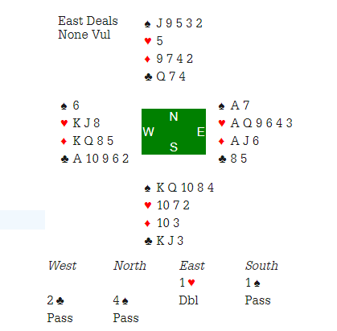
.

Slide 10
Other raises- delayed game raise in a major
With good fit in trumps, often a direct bid to the 4 level is the best option
However with a hand that could be interested in a slam, making a delayed game raise is one possibility. Instead of raising partner direct to game, bid another suit (usually a minor suit), then raise to game. The problem is that opener may think you only have 3 cards in the major suit.
OPENER RESPONDER
1♥ 2♣
2♦ 4♥
♠ Q
♥ A 8 7 5 2
♦ K 4
♣ K Q 9 75
This shows a stronger hand than a direct raise to 4♥.

